Slide 1

Improved Predictive Learning Approaches in Medicinal Services for
Customized Diet Suggestion Framework
Department of Computer Science and Engineering
Under the Guidance of Dr. S. Narayana, M.Tech, PhD Professor & Mentor(AS&A), Department of CSE
By
V. S. N. S. Gayathri - 18481A05L6
Shaik Shabana - 18481A05J8
R. Lakshmi Naveen Kumar - 18481A05I4
V. Rahul Nadh - 18481A05N1

Slide 2
Abstract
In this cutting-edge world many human beings are struggling from extraordinary kinds of ailments and illnesses. A learn about through WHO reviews that insufficient and imbalanced consumption of meals motives round 9% of coronary heart assault deaths, about 11% of ischemic coronary heart ailment deaths, and 14% of gastrointestinal most cancers deaths worldwide.
Moreover, round 0.25 billion teens are struggling from extraordinary sorts of nutrient deficiency specifically from Vitamin-A to Vitamin-K deficiency, 0.2 billion human beings are struggling from Iron deficiency (Anemia), and 0.7 billion human beings are struggling from Iodine deficiency.
The primary goal of this undertaking is to propose a food regimen to one-of-a-kind folks the use of the datasets that are organized based totally on the aggregate of a number nutritional vitamins and their deficiency and meals to be endorsed based totally on which diet is deficient.
In this mission a couple of classifier algorithms are used (KNN, Decision tree, Random forest, Logistic regression, Voting classifier). Ensembled algorithm is used to mix more than one algorithms and instruct a new algorithm. Accuracy of every algorithm is calculated and the high-quality algorithm is used for prediction purposes.
Prediction is proven the use of flask net utility which will observe deficiency of diet and endorse kind of meals to be taken on a range of combos.

Slide 3
Introduction
Balanced nutrition is an important aspect of a healthy lifestyle for people. Along with a balanced diet, regular physical exercise is crucial for a healthy life. Nowadays nutrition and health are often overlooked. The majority of people suffer from diabetes, heart disease, cancer etc.
The diseases are almost directly related to unhealthy eating habits. So, our body needs nutrients to stay healthy, and food supplies with essential nutrients that stop us from getting sick.
A healthy food pyramid is a combination of plant foods, moderate amounts of animal products. Which includes vegetables, grains, fruits, oils and sweets, dairy, meat and beans.
By getting details of user present vitamin values this application can automate the process of detection of vitamin deficiency and food recommendation system using machine learning.

Slide 4
Objectives
To develop a model where vitamin deficiency and food recommendation is predicted based on given input values. Aim is to create our own vitamin deficiency data set for A,B,C,D,E,K and create food recommendation dataset and train both dataset with five machine learning algorithms and find accuracy of each algorithm and use best accuracy model in a web application where vitamin deficiency and food recommendation is predicted based on given input values.
To attain accuracy higher than the existing models for predicting vitamin deficiency and recommending food for it.
To overcome drawbacks of the existing system in recommending the food or diet based on the vitamin deficiency values.

Slide 5
Problem Statement
In this fast paced generation not everyone has the time and money to spend on a personal dietitian and nutritionist who will look upon and take care of their health by advising them a healthy diet plan according to the individual personal information.
By getting details of user present vitamin values this application can automate the process of detection of vitamin deficiency and food recommendation system using machine learning.

Slide 6
Existing System
Content based food recommendation system which recommends food recipes according to the preferences already given by the user. The preferred recipes of the user are fragmented into ingredients which are assigned ratings according to the stored users’ preferences.
The recipes with the matching ingredient are recommended. The authors do not consider the nutrition factors and the balance in the diet. Moreover, chances of identical recommendation are also present because the preference of the user may not change on a daily basis.
The systems recommend different foods for patients without knowing the level of disease which may vary in different cases and cause severe effects on patients, nutrition factors are also ignored which are very much important to recommend food and a balanced diet.

Slide 7
Proposed System
The Proposed System works in a Machine Learning Environment, we use multiple machine learning algorithms to check accuracy of vitamin deficiency and food recommendation and the best model is used for prediction in flask web application.
When the user enters vitamin A, B, C, D, E, K values, the algorithm will predict the deficiency in the vitamin values entered and recommends the food to be taken based on the deficiency in the vitamin values.

Slide 8
Proposed System Continues
For this project we have used the Three-tier architecture along with multiple machine learning algorithms to check the accuracy of vitamin deficiency and food recommendation system and the best model is used for prediction in flask web application. When a user enters vitamin values, the algorithm will predict deficiency in vitamins and recommends food.
1) It automates the process of vitamin deficiency detection and food recommendation.
2) Previous datasets are used for training and testing.
3) Accuracy of the model is improved compared to existing methods.

Slide 9
Proposed System Continues
The three-tier software architecture emerged in the 1990s to overcome the limitations of the two-tier architecture. The third tier is between the user interface and the data management components.
This middle tier provides process management where business logic and rules are executed and can accommodate hundreds of users by providing functions such as queuing, application execution, and database staging.
This is used when an effective distributed client/server design is needed that provides increased performance, flexibility, maintainability, reusability, and scalability, while hiding the complexity of distributed processing from the user.
These characteristics have made three layer architectures a popular choice for Internet applications and net-centric information systems.

Slide 10
Proposed System Continues
The recommendation process has basically three stages that are Information Collection Phase, Learning Phase and Recommendation Phase.
The information is firstly collected about a particular problem and the various solutions related to that problem are categorized. After the collection of information the Learning Phase comes in which various conclusions are made out of that information which is gathered.
In the last phase i.e., Recommendation Phase an output is given in which various recommendations are made.

Slide 11
Proposed System Continues
In this project its own data set is prepared based on various high and low values of vitamins from (vitamin a, b, c, d, e, k) and features are divided from normal and abnormal conditions of vitamins and labels are divided into 0 and 1 as normal and abnormal. Another dataset is prepared based on a combination of various vitamins and their deficiency and the food to be recommended based on which vitamin is deficient. Multiple classifier algorithms are used (knn, decision tree, random forest, logistic regression, voting classifier) ensembled algorithm is used to combine multiple algorithms and train a new algorithm.
Accuracy of each algorithm is calculated and the best algorithm is used for prediction purposes.
Prediction is shown using a flask web application which will detect deficiency of vitamins and recommend types of food to be taken on various combinations.

Slide 12
Proposed System Continues
KNN Algorithm
K-NN algorithm stores all the available data and classifies a new data point based on the similarity. This means when new data appears then it can be easily classified into a well suite category by using K- NN algorithm.
Decision Tree
It is a graphical representation for getting all the possible solutions to a problem/decision based on given conditions.
Random Forest
Random Forest is a classifier that contains a number of decision trees on various subsets of the given dataset and takes the average to improve the predictive accuracy of that dataset
Logistic Regression
It is used for predicting the categorical dependent variable using a given set of independent variables.
Voting Classifier
It is a machine learning estimator that trains various base models or estimators and predicts on the basis of aggregating the findings of each base estimator. The aggregating criteria can be combined decision of voting for each estimator output.

Slide 13
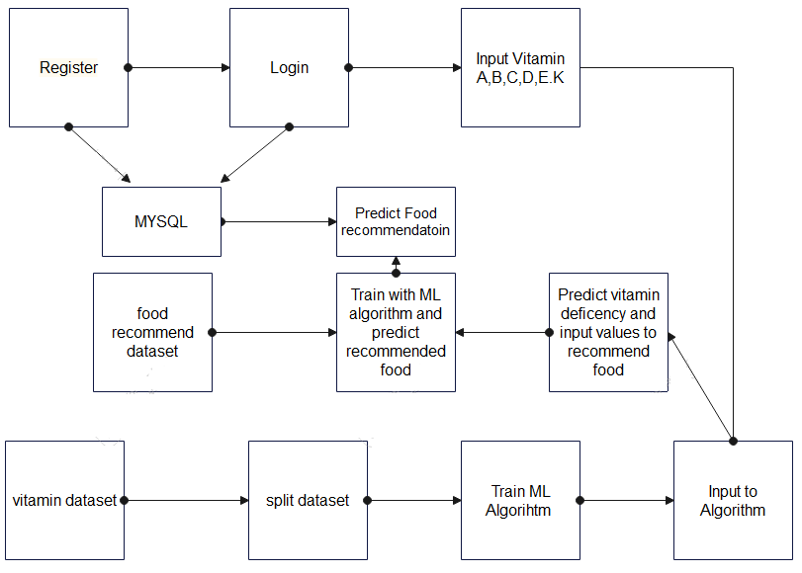
System Architecture

Slide 14
Implementation
NumPy is the fundamental package for scientific computing in Python. It is a Python library that provides a multidimensional array object, various derived objects.
Seaborn is a library for making statistical graphics in Python. It builds on top of matplotlib and integrates closely with panda’s data structures.
Matplotlib is an amazing visualization library in Python for 2D plots of arrays.
Pandas is a Python package providing fast, flexible, and expressive data structures designed to make working with “relational” or “labeled” data.
Scikit-learn is a library in Python that provides many unsupervised and supervised learning algorithms. We are using it for splitting the dataset into train and test sets.
Keras is an open source software library that provides a python interface for artificial neural networks.

Slide 15
Implementation continues
Data Collection
Vitamin dataset and food recommendation dataset which is prepared based on min and max vitamin values from the test results .
Pre-Processing
Data is preprocessed by standard scalar function and new features and labels are generated.
Test and Train
Train variables are used for passing to algorithm whereas test variables are used for calculating accuracy of the algorithm.
Predict deficiency and recommend food
Used KNN, Random Forest, Logistic Regression, Voting classifier , Decision Tree algorithms to predict the best algorithm based on the accuracy.
After finding best algorithm, from users input, the algorithm will predict the deficiency and recommend food.

Slide 16
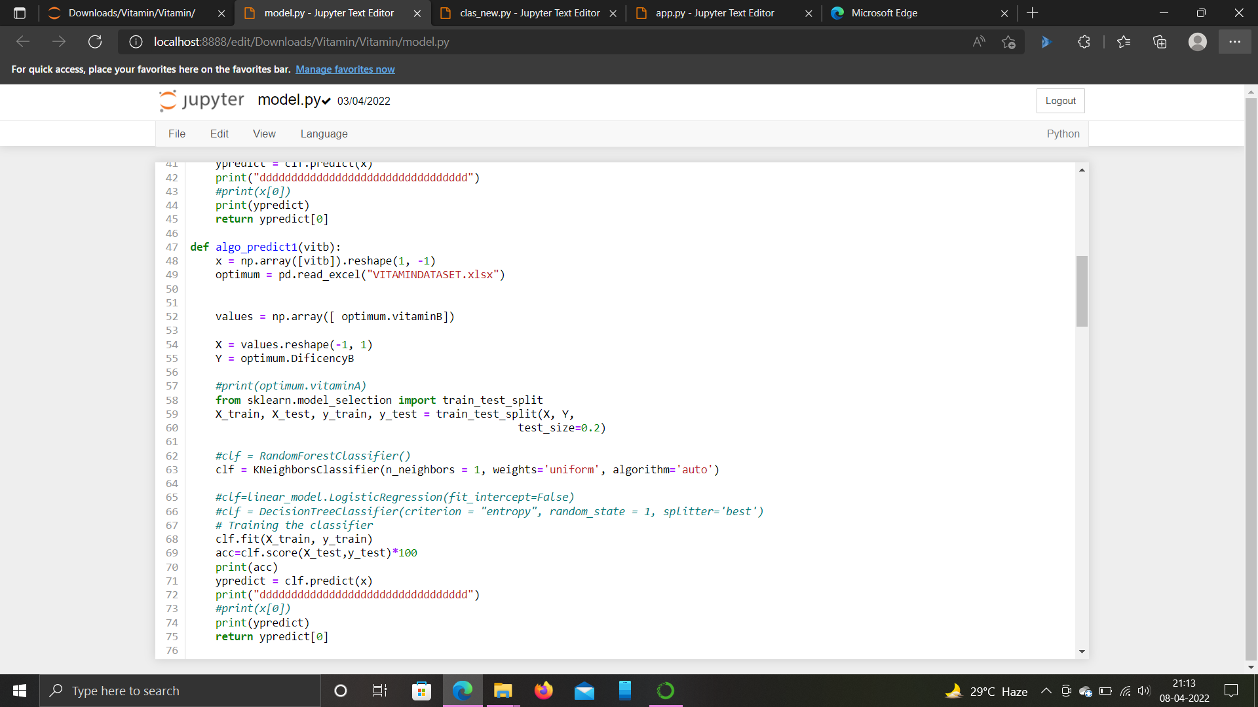
Implementation Continues

Slide 17
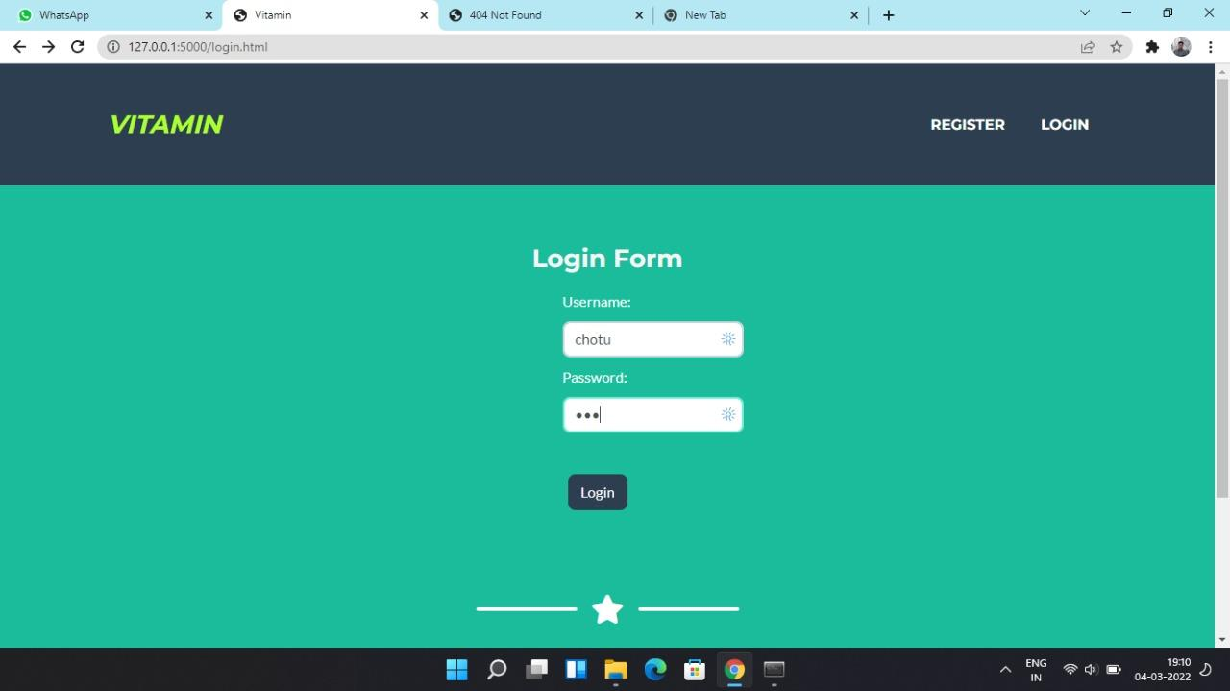
Results

Slide 18
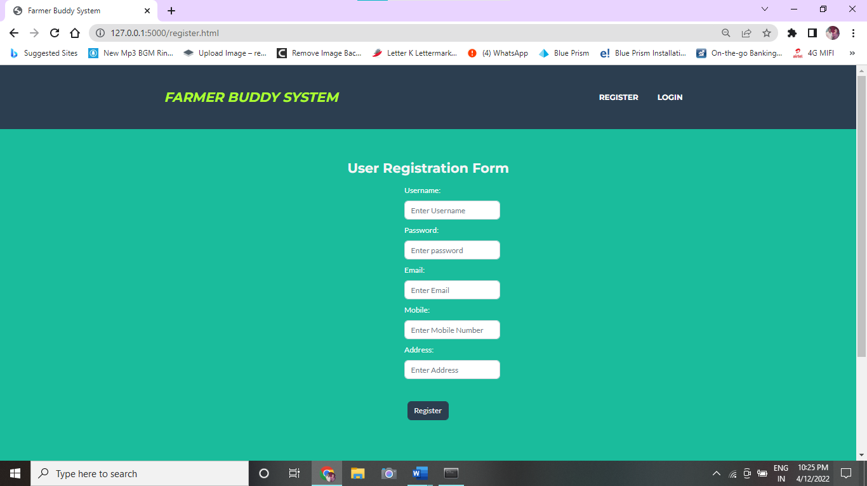

Slide 19
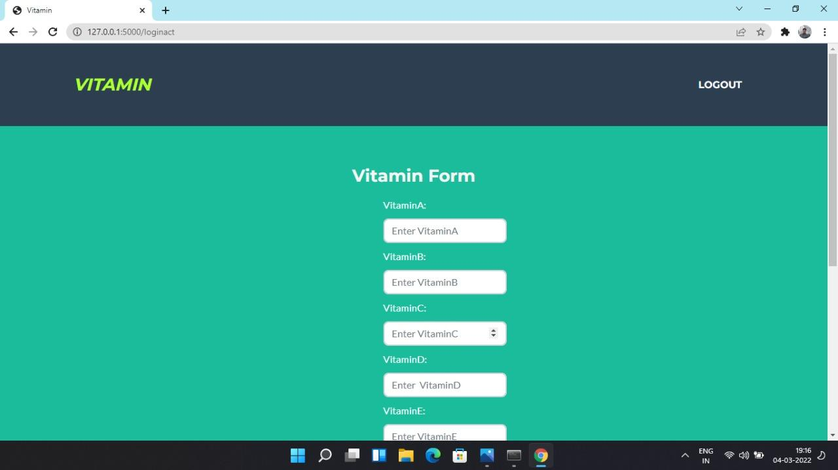

Slide 20
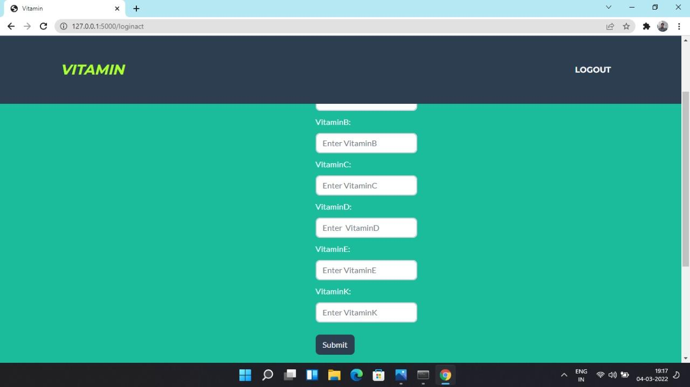

Slide 21
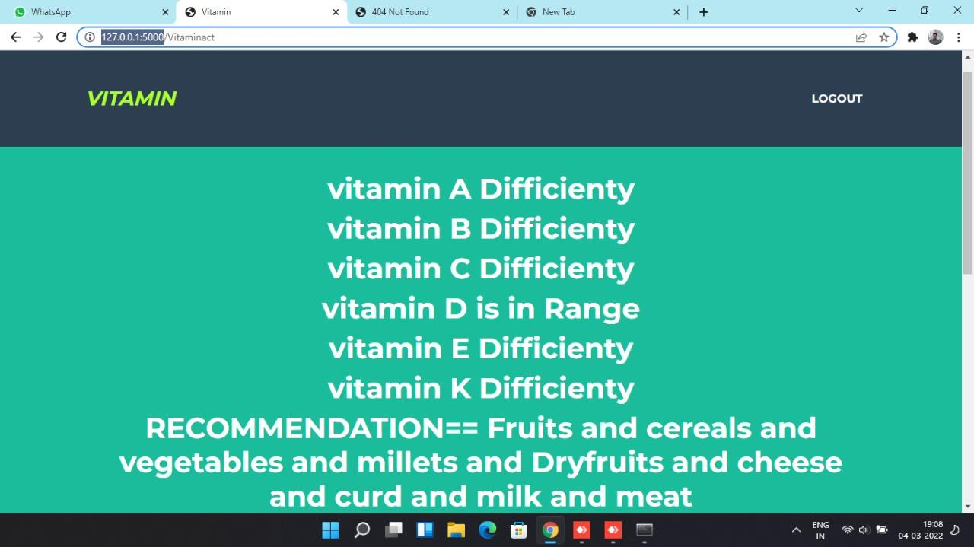

Slide 22
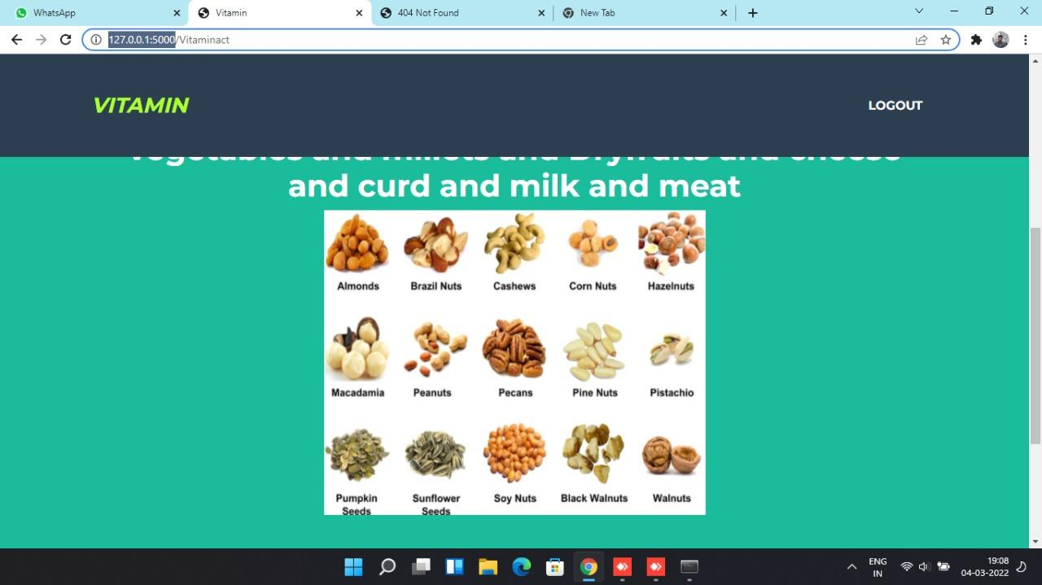

Slide 23
Paper Information
Journal Name : International Journal for Innovative Engineering and Management Research
Journal Cost : 3500
Journal Hyperlink :
8.pdf

Slide 24
Conclusion
We have created a website which recommend the food items and predicts vitamin deficiency in which we have implemented prediction by taking input as vitamins and their deficiency.
For training of the system, the initial process involves the dataset preparation of food items depending upon the vitamin deficiency. The prediction of various food recommendation depending upon which are essential for the for type of vitamin deficient.
After the clustering is performed, using Random Forest classifier, the nearest food items are predicted which best suited for the appropriate diet. Our diet recommendation system allows users to basically get the desired healthy diet on the bases of vitamin deficiency.

Slide 25


